Slide 1

Real World Whiteboard Design Session Case Study
Lift and Shift

Slide 2

Step 1: Review the customer case study
Notes:
Step 1 of the case study involves reviewing the details of the case study.
This should take 15 minutes and result in an analysis of the customer’s needs.

Slide 3
Customer situation Lucerne Publishing
Lucerne Publishing is one of the largest English- language publishers in the world, and with nearly 200 years of history, Lucerne has published some of the world’s foremost authors
Lucerne is consistently at the forefront of innovation, using digital technology to create unique reading and viewing experiences and expand the reach of its authors and documentary producers
Lucerne is headquartered in New York City and has publishing groups in the United States, United Kingdom, Canada, Australia, and New Zealand
Notes:
Let’s dive into the customer’s situation
Read slide verbatim

Slide 4
Customer situation Lucerne Publishing
Lucerne is starting a three-year project to move the majority of its data center footprint to the cloud
“We are convinced that cloud implementations will give us cost savings and, more importantly, deliver operational flexibility,” says Greg Vernon, Head of Infrastructure and Enterprise Operations
Lucerne has already enabled a successful implementation of Office 365 where it used Microsoft Azure Active Directory (AD) Connect to synchronize its on-premises identities to the cloud
Lucerne wants to pilot a relatively high-impact workload directly in Microsoft Azure. The workload is a third-party procurement system that is hosted on-premises today and Lucerne would like to migrate it to Azure with minimal changes
Notes:
Read slide verbatim

Slide 5
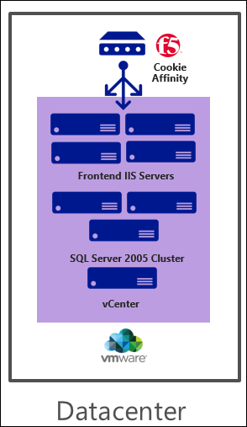
Procurement system
Current situation
Third-party app deployed on four Windows 2008 R2 Microsoft Internet Information Services (IIS) VMWare VMs that are managed by vCenter
ASP.NET with .NET 3.5
App deployed via a wizard to install assemblies into the global assembly cache (GAC)
IIS hardware: 2 vCPUs Xeon processors and 6 GB of memory on each server
F5 to balance to load across VM
Backend SQL 2005/Failover Cluster (app is compatible with SQL Server 2016)
App uses distributed queries, heavy use of TempDB, and SQL Server Reporting Services (SSRS), and has a maximum database size of just 200 GB
SQL hardware: 8 vCPUs Xeon processors and 16 GB of memory on each server
Notes:
Let’s elaborate on the procurement system that is in place

Slide 6
Customer needs
Identify the infrastructure requirements and plan the migration
Migrate the web tier to Azure with minimal changes to the application itself
Create a migration plan for the database tier
Understand how offsite backup will work after migration (for application and data workloads) (ADVANCED)
Notes:
The customer’s needs in this case study include the following:

Slide 7
Step 2: Call to action: Design a proof of concept solution
Outcome
Design a solution and prepare to present it
Timeframe
45 minutes
Design (35 minutes) | Design a solution for as many of the stated requirements as time allows. Show the solution on a flip chart.
Prepare (10 minutes) | Prepare for a 10-minute presentation to the proctor.
Notes:
For Step 2 of this case study – you should design a proof of concept solution with the target customer audience in mind in a 15-minute chalk talk format.
Spend some time responding to the questions outlined in your guide and list the answers on a flip chart.
Design a solution for as many of the stated requirements as time allows.
And finally prepare a presentation with a target time of 15 minutes to present to the customer.
The total time allotted for Step 2 is 130 minutes.

Slide 8
Wrap-up
Outcomes
Identify the preferred solution for the case study.
Identify solutions designed by other teams.
Timeframe
15 minutes
Notes:
We will now wrap up this case study – although there are many ways to accomplish the same outcome, we will discuss one of the preferred solutions.

Slide 9
Real World Whiteboard Design Case Study
Lift and shift
Preferred solution

Slide 10
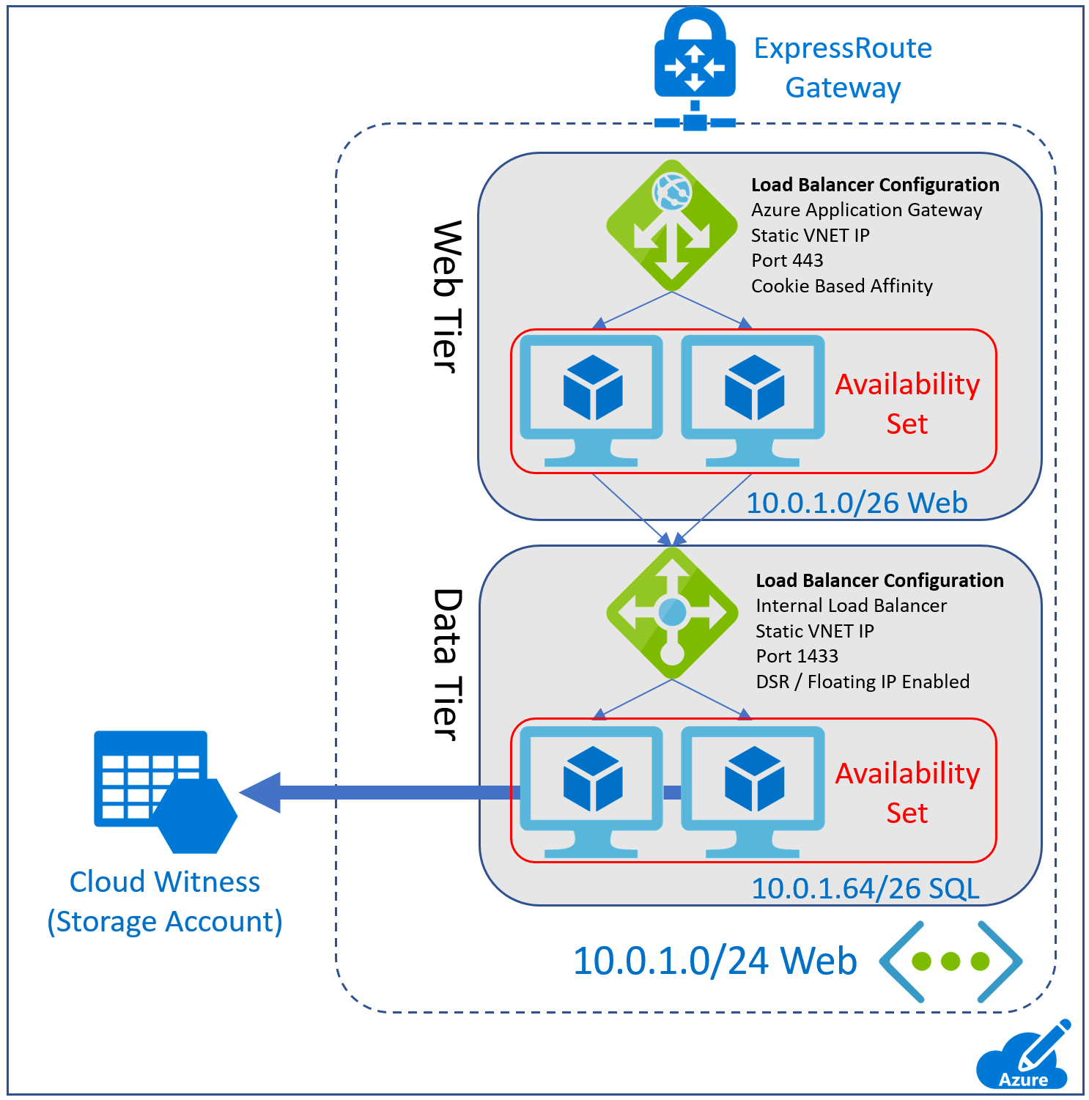
Procurement Web Migration Overview
Option 1: Migrate the IIS servers to Azure using Azure Site Recovery (ASR).
Option 2: Convert VMware VMs to Azure VMs using the Starwind V2V Converter and upload as specialized images
Option 3: Create infrastructure manually and manually reinstall
Load Balancer Configuration:
External load-balancer (ILB) to balance load
ILB for SQL with Direct Server Return for Always On
Web VMs: DS2_v2 in an Availability Set
SQL VMs: DS3_v2 in an Availability Set
Notes:
The procurement migration should include a plan to migrate the IIS VMs to Azure using Azure Site Recovery as the application has a dependency on its install wizard that installs assemblies to the GAC
Be sure to configure these virtual machines in an availability set on each tier.
For SQL, the proposed solution should migrate to virtual machines for SQL 2014 with Always On availability groups configured.
NOTE: The DS3 instance size is the closest match to what the current hardware of the sql server cluster is today.
With the workloads being in Azure, you can capitalize on Azure backup for SQL backup and point in time restore, as well as your virtual machine backup (both the windows and Linux based workloads)
For the load balancer configuration, Lucerne should leverage Azure Application Gateway internal load balancer and cookie based affinity and the Internal load balancer for SQL with direct server return for always on

Slide 11
Procurement migration overview
Migrate to VMs for SQL Server 2016 with Always On.
DS3_v2 instance size deployed into a Availability Set
Cloud Witness (Storage Account)
Backup:
SQL Server Managed Backup to Microsoft Azure
Or use Microsoft Azure Backup Server
Notes:
The procurement migration should include a plan to migrate the IIS VMs to Azure using Azure Site Recovery as the application has a dependency on its install wizard that installs assemblies to the GAC
Be sure to configure these virtual machines in an availability set on each tier.
For SQL, the proposed solution should migrate to virtual machines for SQL 2014 with Always On availability groups configured.
NOTE: The DS3 instance size is the closest match to what the current hardware of the sql server cluster is today.
With the workloads being in Azure, you can capitalize on Azure backup for SQL backup and point in time restore, as well as your virtual machine backup (both the windows and Linux based workloads)
For the load balancer configuration, Lucerne should leverage Azure Application Gateway internal load balancer and cookie based affinity and the Internal load balancer for SQL with direct server return for always on

Slide 12
Option 3: Rebuild
Step 1: Create a storage account, virtual network, and establish hybrid connectivity (Customer asked for ExpressRoute).
Step 2: Update the virtual network to reference the domain controllers on-premises in DNS.
Step 3: Use the Azure portal, PowerShell or a template to create the VMs for the web tier from disks into an availability set running Windows Server 2016 Datacenter Web servers.
Step 4: Using the install wizard to manually install the application again, making sure to configure anything per the vendors instructions or restore any configurations that might be required for the application from the on-premises servers.
Step 5: Create public facing load balancer with static ip address. Add VM to backend pool.
Step 6: Update DNS to map the hostname https://procurement to the static IP of the load balancer
Step 7: Complete the SQL Migration and update the connection strings.

Slide 13
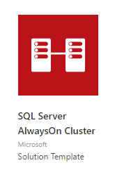
SQL Server Migration steps Details
SQL Server Migration
Since the SQL Server is being upgraded from SQL Server 2005 to SQL Server 2016, a rebuild is required. To accomplish this and migrate the DB to Azure, use the following steps:
Step 1: Build a SQL Cluster in Azure
Create a Premium Storage Account.
Using a template from the Azure Marketplace, deploy a SQL Server 2016 Always On Cluster.
Make sure to choose the correct region, Virtual Network, and subnet that are designated for database servers. Standard DS3_V2 for the SQL Servers and a dedicated storage account for the Cloud Witness.
Update the Network security groups to allow traffic between the web tier and the data tier subnets only on port 1433 from the web tier subnet. Consider other Network Security Group (NSG) rules to secure the data.
Step 2: Back up the DB from the Production Server
Take a full backup of the SQL database onsite and upload it to Blob Storage using Storage Explorer.
Use one of the VMs to download the file from storage and restore it to one of the nodes on the SQL Server.
Configure the database to be protected by the SQL AOG.
Ensure that your SQL AOG Listener name is properly registered in DNS and resolvable on the Vnet.
Step 3: Migration Night
The night of the migration the same backup and restore steps will need to be taken in order to ensure that the latest data is available.

Slide 14
Hackathon

Slide 15
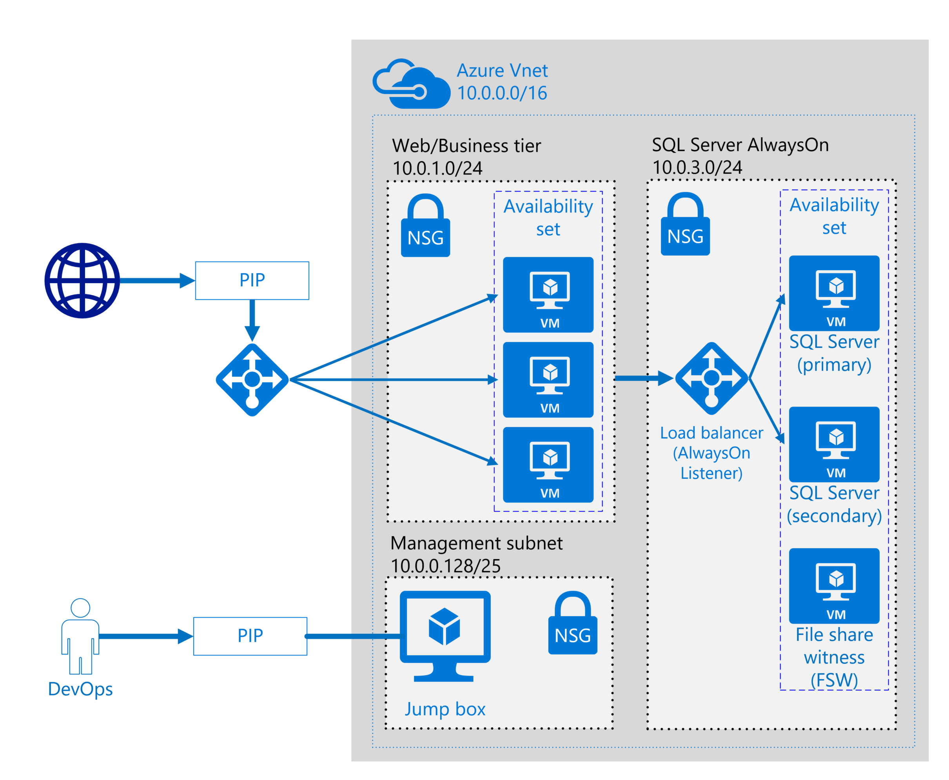
Build an 2-Tier architecture in Azure using the portal based on what we learned today

